Slide 1
CSD Study Abroad Options

Slide 2
Communication Disorders in England, Ireland and Scotland
Faculty led
Dr. Paul Cooke
32nd year
London, England; Dublin, Ireland; and Edinburgh, Scotland
Open to upper division undergraduate and graduate students in communication disorders.

Slide 3
Communication Disorders in England, Ireland and Scotland
Guest Lectures + Site Visits
valuable exposure to various therapy techniques and professional philosophies and issues
comparisons between clinical practices in England, Ireland, Scotland and the USA
Comparisons between our service delivery model and those with a national health system
Course: CSD 419 (6 cr)
Provides additional CSD coursework on transcript
Will waive all 5 COM elective credit for COM majors

Slide 4
Communication Disorders in England, Ireland and Scotland
Info Session– Learn More!
Sunday, September 25th
2-4p
107 Oyer Building
~or~
Contact Paule Cooke (cooke@msu.edu)

Slide 5
Massey University (New Zealand)
Semester long option
Ranked one of top 3 universities in NZ

Slide 6
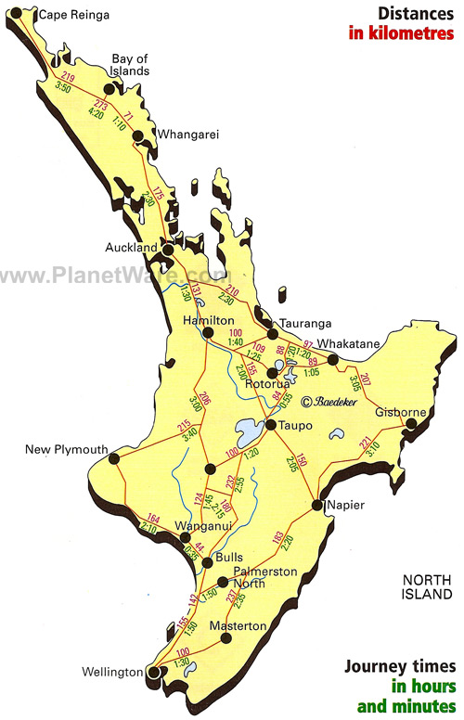
Massey University-the Campus
Palmerston North, NZ Campus
The Campus
Best Experiences in NZ

Slide 7
Massey University-The Courses
4 classes = 16 MSU credits (tuition based on 16 cr.; will not change if you go lower)
CSD classes would show up with grades on MSU transcript

Slide 8
Massey Course Title | Massey Credits | MSU Course Equivalent | MSU Credits
Introduction to Communication Disorders | 15 | CSD 203 Introduction to Communicative Sciences and Disorders + CSD GCU (1) | 4
Anatomy and Physiology of Speech and Hearing | 15 | CSD 213 Anatomy and Physiology of the Speech and Hearing Mechanisms + CSD GCU (1) | 4
Speech and Language Development | 15 | CSD 333 Oral Language Development + CSD GCU (1) | 4
Child Language Disorders I | 15 | CSD 491 Special Topics | 4
Articulation and Phonological Disorders in Children | 15 | CSD 473 Phonological Disorders in Children + CSD GCU (1) | 4
Assessment Methods for Speech and Language Disorders | 15 | CSD 364 Speech and Language Disorders and Their Evaluations + CSD GCU (1) | 4
Field Work and Clinical Skills I | 15 | CSD 491 Special Topics | 4
Child Language Disorders II | 15 | CSD 491 Special Topics | 4
Neurogenic Communication Disorders I | 15 | CSD 491 Special Topics | 4
Technology in Communication Disorders | 15 | CSD 491 Special Topics | 4
Neurogenic Communication Disorders II | 15 | CSD 491 Special Topics | 4
Motor Speech Disorders | 15 | CSD 491 Special Topics | 4
Fluency Disorders | 15 | CSD 491 Special Topics | 4
Field Work and Clinical Skills II | 15 | CSD 491 Special Topics | 4
Adult Dysphagia | 15 | CSD 491 Special Topics | 4
Paediatric Dysphagia | 15 | CSD 491 Special Topics | 4
Aural Rehabilitation, Assessment and Intervention | 15 | CSD 444 Audiologic Assessment and Intervention/ Rehabilitation + CSD GCU (1) | 4
Voice Disorders, Assessment and Treatment | 15 | CSD 491 Special Topics | 4

Slide 9
Massey University-the cost
Reasonably prices (approx. $8900 USD for 16 cr. tuition)
All MSU aid continues to work
Eligible for ComArtSci Study Abroad Scholarship (approx. $2000)
3.5+, apply for Office of Study Abroad Merit Based Scholarship
Massey “Generation Study Abroad Scholarship”: US citizens or residents can apply for a US $2,000 travel award to help with flights to New Zealand and US $500 towards study abroad or student exchange at Massey University.

Slide 10
Massey University-Learn More!
MSU Educational Abroad Expo (Study Abroad Fair)
Thursday, October 6th, 12-6pm, Breslin Center
Gregory Huff
Advising appointment with Jennifer
Application deadline for SS17: October 1st

